Slide 1
How to talk to SUMO through python API
Wushuang Bai
2022 06 20

Slide 2
The purpose of this presentation is to demonstrate how to run SUMO simulation using python API through a simple example.

Slide 3
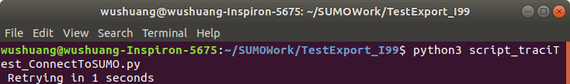
Example 1. Connect to SUMO using python API. Step 1. Run the script script_traciTest_ConnectToSUMO.py using command "python3 script_traciTest_ConnectToSUMO.py".

Slide 4
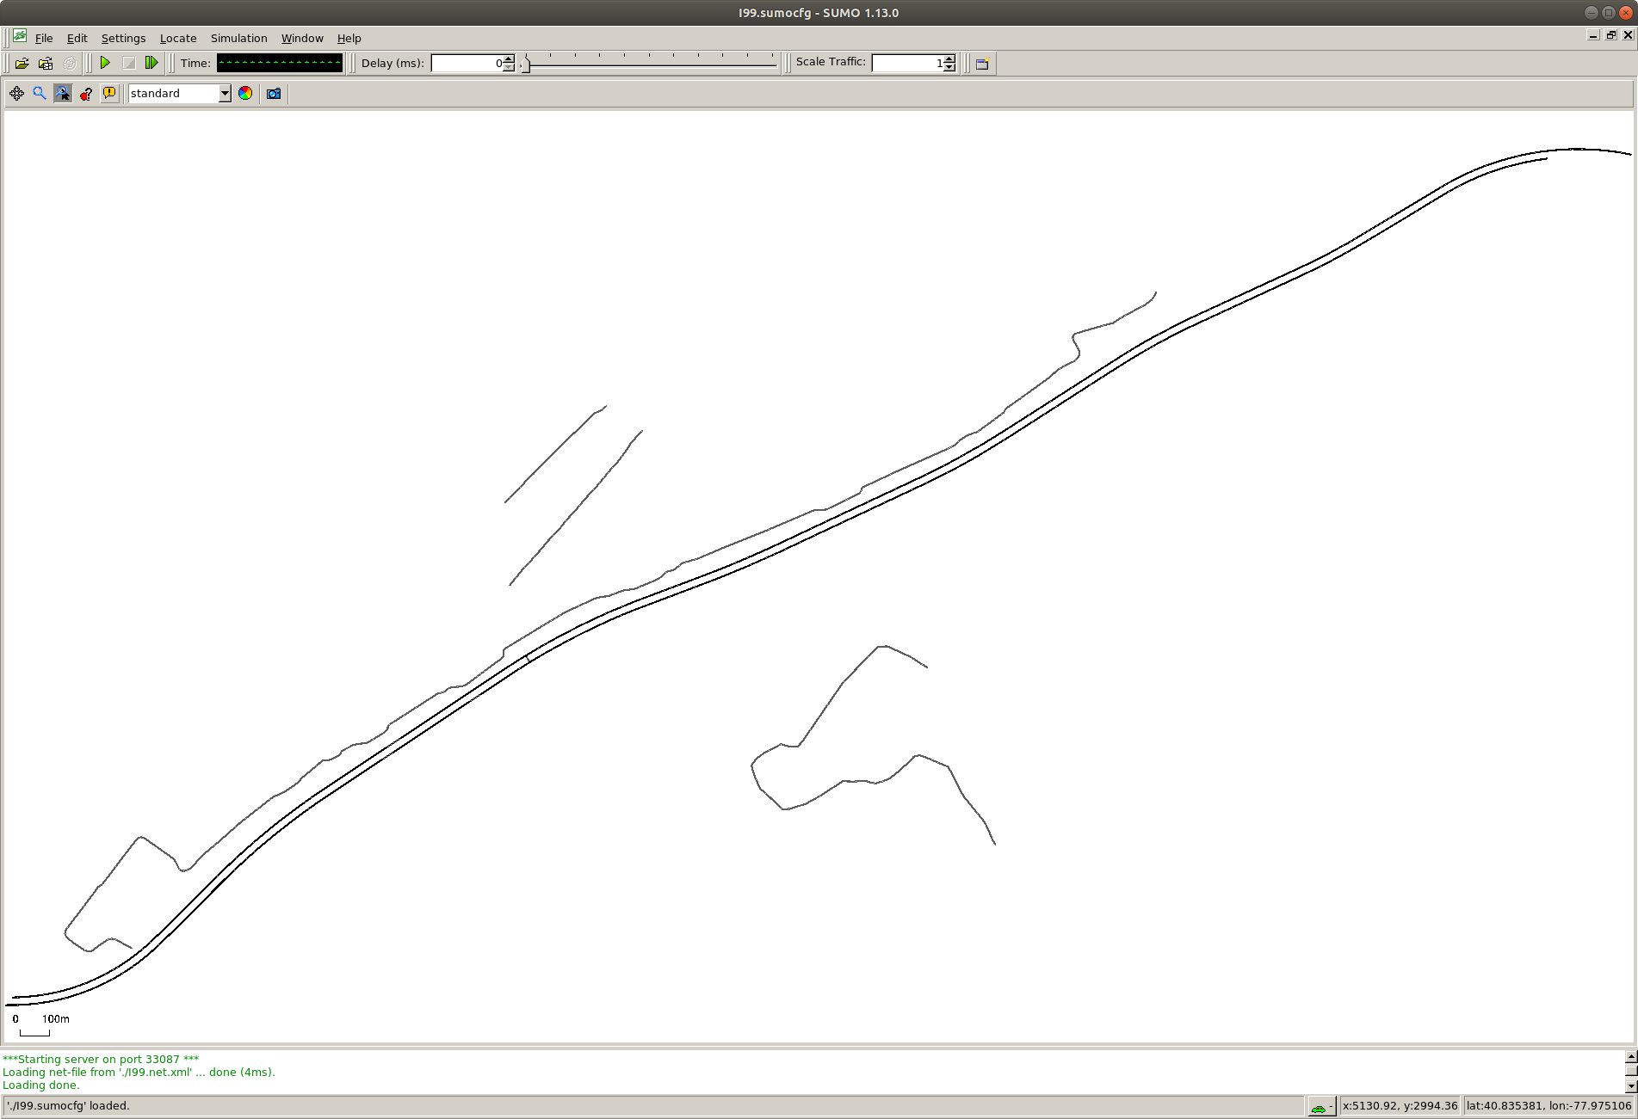
Step 2. SUMO GUI pops up.

Slide 5
Step 3. Click on play button to start the simulation. You can add some delay to visualize the simulation process better, for example, 100 ms.

Slide 6
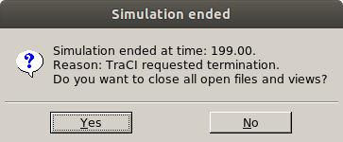
Step 4. Once the simulation ends as controlled by the script, window pops up indicating simulation ends.

Slide 7
Example 2. Read out vehicle data live during simulation using python API. Step 1. Run the script script_traciTest.py using command "python3 script_traciTest_ConnectToSUMO.py".

Slide 8
Step 2. SUMO GUI pops up.

Slide 9
Step 3. Click on play button to start the simulation. You can add some delay to visualize the simulation process better, for example, 100 ms.

Slide 10
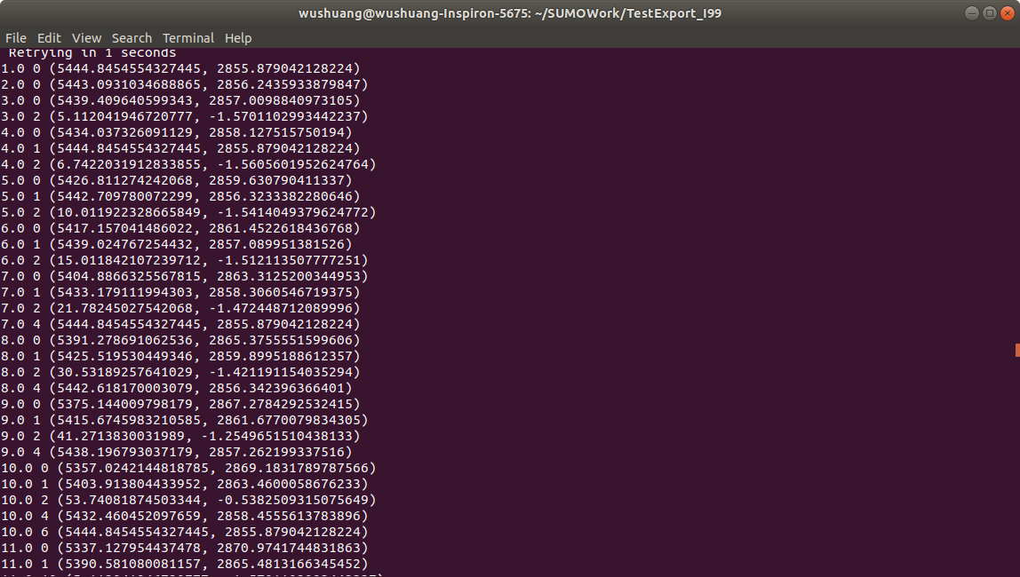
Step 4. Once simulation runs, the vehicle data reads out live. This example script reads out simulation time, vehicleID, vehicle position. Users can customize it as needed.

Slide 11
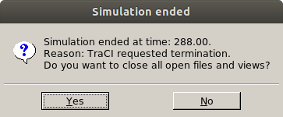
Step 5. Once the simulation ends as controlled by the script, window pops up indicating simulation ends.

Slide 12
Please download the simulation files and script used in this tutorial using the links:
Simulation files can be found here: https://github.com/ivsg-psu/TrafficSimulators_GettingStartedWithDifferrentSimulators_GettingStartedWithSUMO/tree/main/Data
Script can be found here:https://github.com/ivsg-psu/TrafficSimulators_GettingStartedWithDifferrentSimulators_GettingStartedWithSUMO/tree/main/Code
For more information, please see https://sumo.dlr.de/docs/TraCI.html#examples

